Slide 1

ART OF TEA

Slide 2
Analyzing customer behavior and predicting effective customer communication strategy with respect to Frequency , Recency and Average order To Maximize Retention.

Slide 3
Art of tea team deeper dive
Figuring out the factors affecting retention
If Email Campaign’s have any effect on it
What role does location plays in if any.
Does different types of delivery style affect the customers intention for re ordering
If any particular day of the week we need to focus on in terms of order frequency.

Slide 4
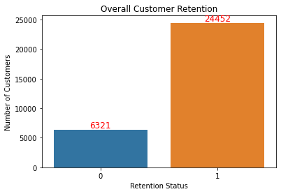
Exploring the data

Slide 5
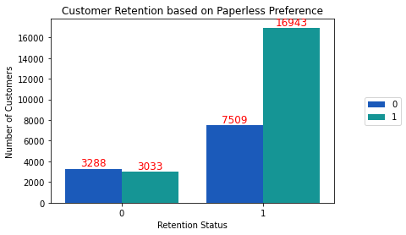

Slide 6
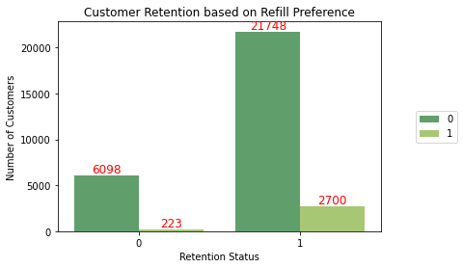

Slide 7
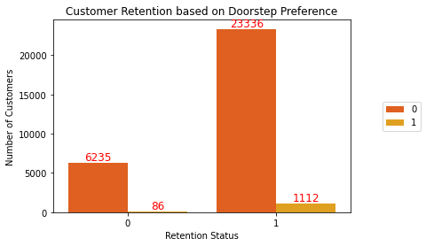

Slide 8
Classification Models
 | SCORE | MODEL
0 | 95.45 | Random Forest
1 | 94.63 | Logistic Regression
2 | 93.09 | Decision Tree

Slide 9
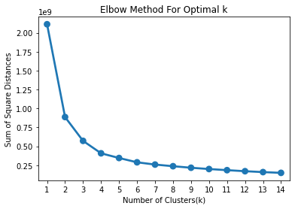
Optimal number of K in KMeans

Slide 10
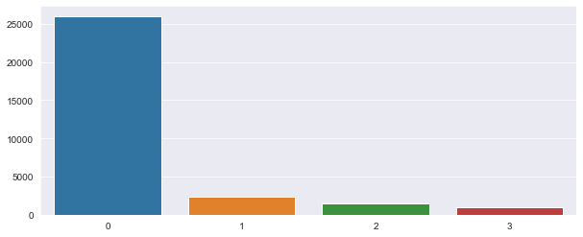
Clusters through K means

Slide 11
RFM model
Recency, frequency, monetary
Establish and group customers in clusters of their respective effect on the Business.
Using RFM model we dived the customers in three categories
PLATINUM>GOLD >SILVER>BRONZE

Slide 12
Location
city | custid
1 | BOM | 11551
2 | DEL | 8778
3 | MAA | 8739
0 | BLR | 1696
We can see that Mumbai is on top of the metros we serve in terms of revenue.

Slide 13
Converting data
 | Customer ID | Recency | Frequency | Monetary
0 | 2229GF | 417 | 1 | 41.42
1 | 223KBA | 361 | 1 | 40.20
2 | 22476K | 447 | 1 | 40.02
3 | 224L8Q | 405 | 1 | 51.72
4 | 2253X7 | 325 | 1 | 31.00

Slide 14
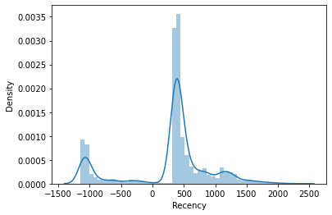
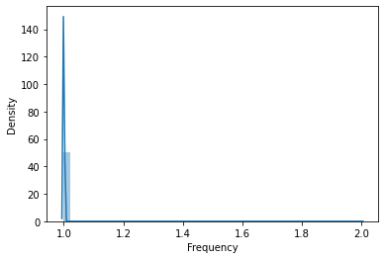
We can see the density distribution of Recency, Frequency..

Slide 15
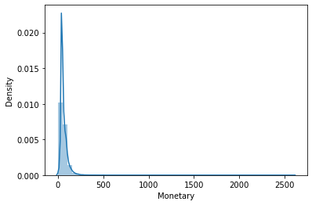
And Monterey

Slide 16
Quartlies
Recency: {0.25: 322.0, 0.5: 396.5, 0.75: 527.0},
Frequency: {0.25: 1.0, 0.5: 1.0, 0.75: 1.0},
Monetary: {0.25: 40.02, 0.5: 50.97, 0.75: 74.28}}

Slide 17
Final Groups
 | Custid | Recency | Frequency | Monetary | R | F | M | RFMGroup | RFMScore | RFM_ Loyalty_ Level
0 | 2229GF | 417 | 1 | 41.42 | 3 | 4 | 3 | 343 | 10 | Silver
1 | 223KBA | 361 | 1 | 40.20 | 2 | 4 | 3 | 243 | 9 | Gold
2 | 22476K | 447 | 1 | 40.02 | 3 | 4 | 4 | 344 | 11 | Bronze
3 | 224L8Q | 405 | 1 | 51.72 | 3 | 4 | 2 | 342 | 9 | Gold
4 | 2253X7 | 325 | 1 | 31.00 | 2 | 4 | 4 | 244 | 10 | Silver

Slide 18
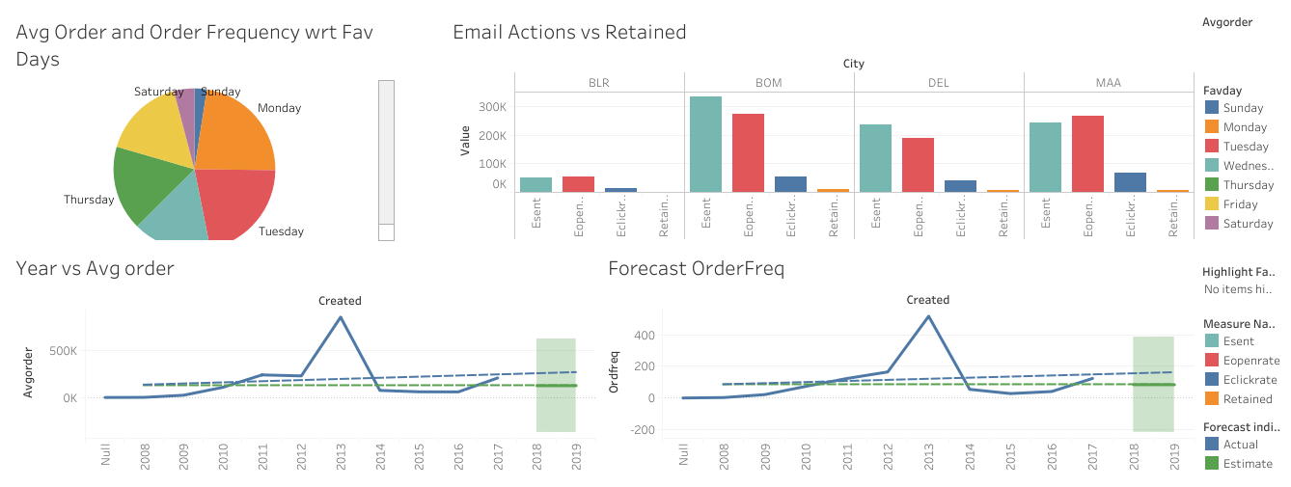
Dash Board

Slide 19
Thank You

